Slide 1
THE PREVALENCE AND ASSOCIATED FACTORS OF GOITER AMONG WOMEN IN HARGEISA GROUP HOSPITAL SURGICAL CLINIC IN HARGEISA, SOMALILAND
Presenter: Dr Afnan Nuh
General surgeon
University lecturer
Hargeisa Group Hospital

Slide 2
Goiter is a term used to describe any enlargement the thyroid gland,
Thyroid disease is common endocrine problem in our community,
Majority of the patients with goiter come from Northern and Eastern region of Somaliland where there is iodine deficiency mainly.
Goiter, linked by various risk factors, is highly prevalent in the region of Hargeisa, Somaliland. And it is a serous health issue among women living in our territory.

Slide 3
Objective of the study
General objective: is to asses the prevalence and associated factors of goiter among women in HGH(Hargeisa Group Hospital) surgical clinic
Specific objective:
To determine the prevalence of goiter among patient attending HGH
To determine the association between sociodemographic factors and goiter among patients attending Hargeisa group hospital
To find out the association between dietary factors and goiter among patients attending HGH

Slide 4
In a study we conducted last year, a cross sectional analysis from the patients who visit our out-patient clinic of general surgery HGH.
Among the data we collected between January to August 2022 a total of 1659 patients visited the general surgery outpatient clinic of HGH .
The study sample was distributed equally by those diagnosed with goiter and those who were not.
And independent risk factors were defined by making comparisons among the groups.

Slide 5
Results The figure shows the prevalence of goitre in Hargeisa Group Hospital

Slide 6
Duration of thyroid mass among Study Participants

Slide 7
Prevalence of goiter
Factors related to goiter development
Socio-demographic
Goitre
(Present or Absent)
Diet (Utilization of iodized salt)
Diet (use of cabbage)

Slide 8
Conclusion of the research study
This study provides additional evidence that the prevalence of goiter in HGH is 9.6%.
Diet like cabbage, parity and iodine status are the major factors associated with the prevalence of goiter in females among HGH surgical clinic,
whereas employment status has not being related to goiter.

Slide 10
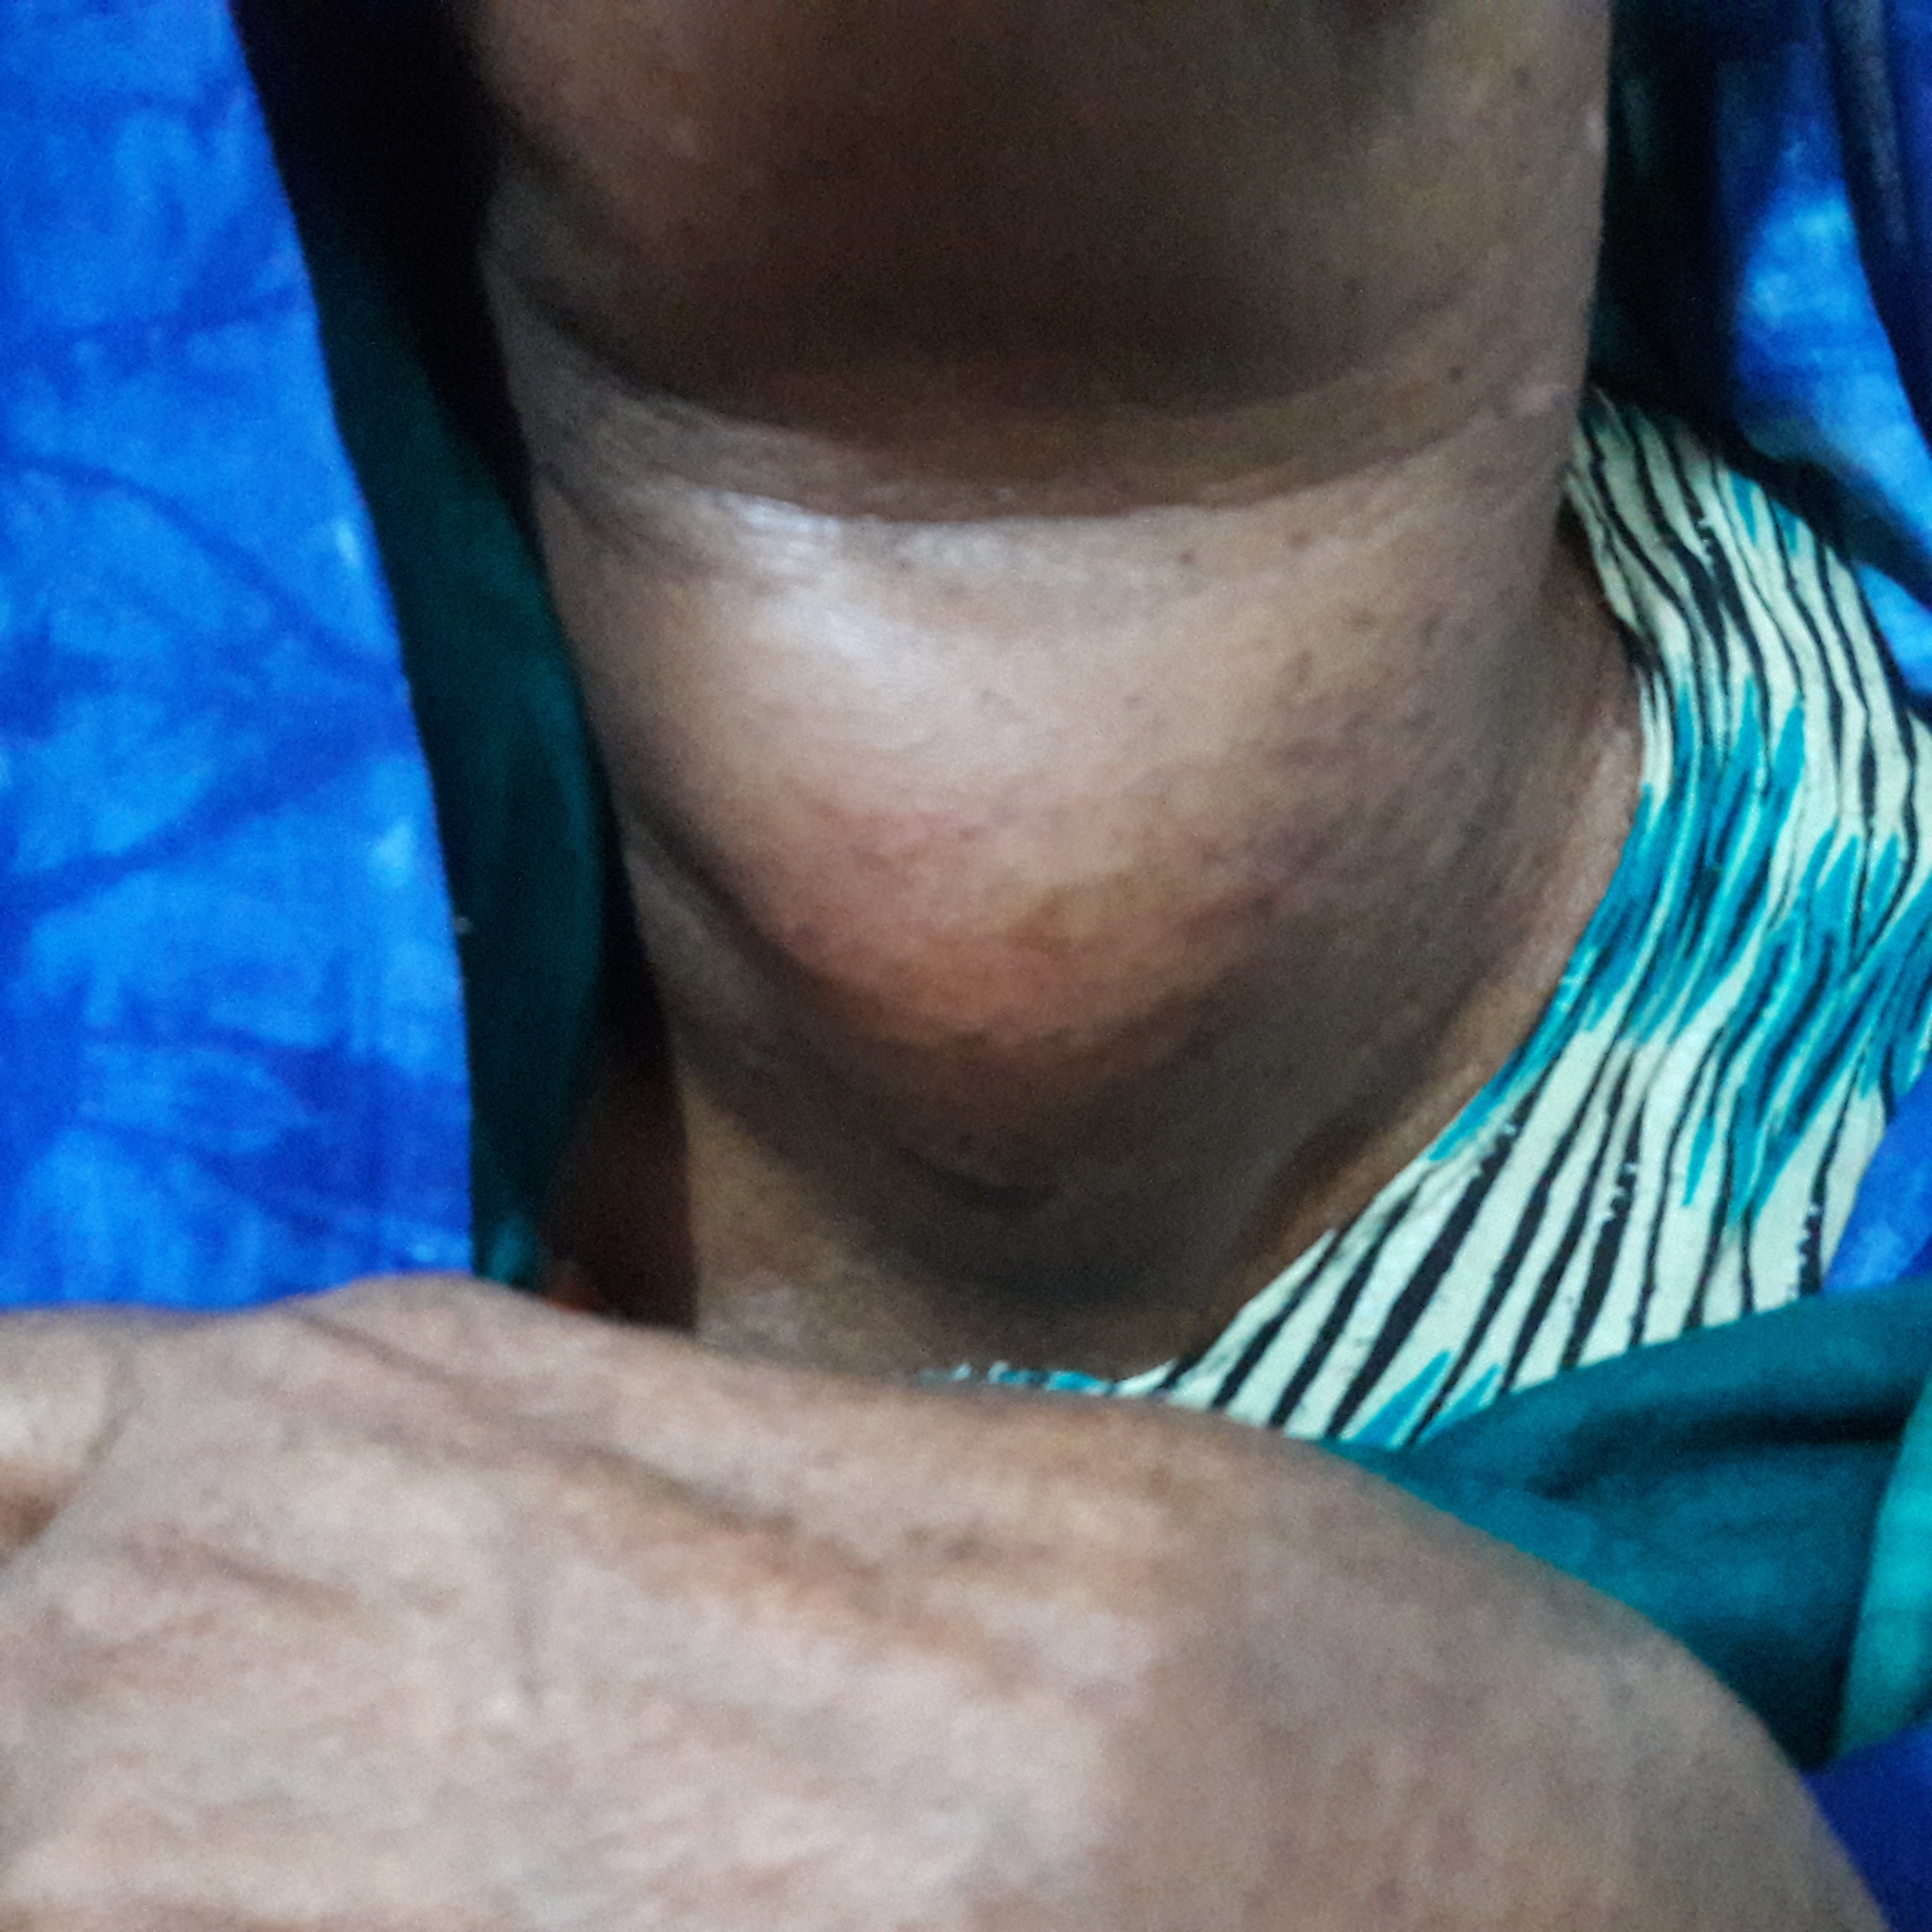
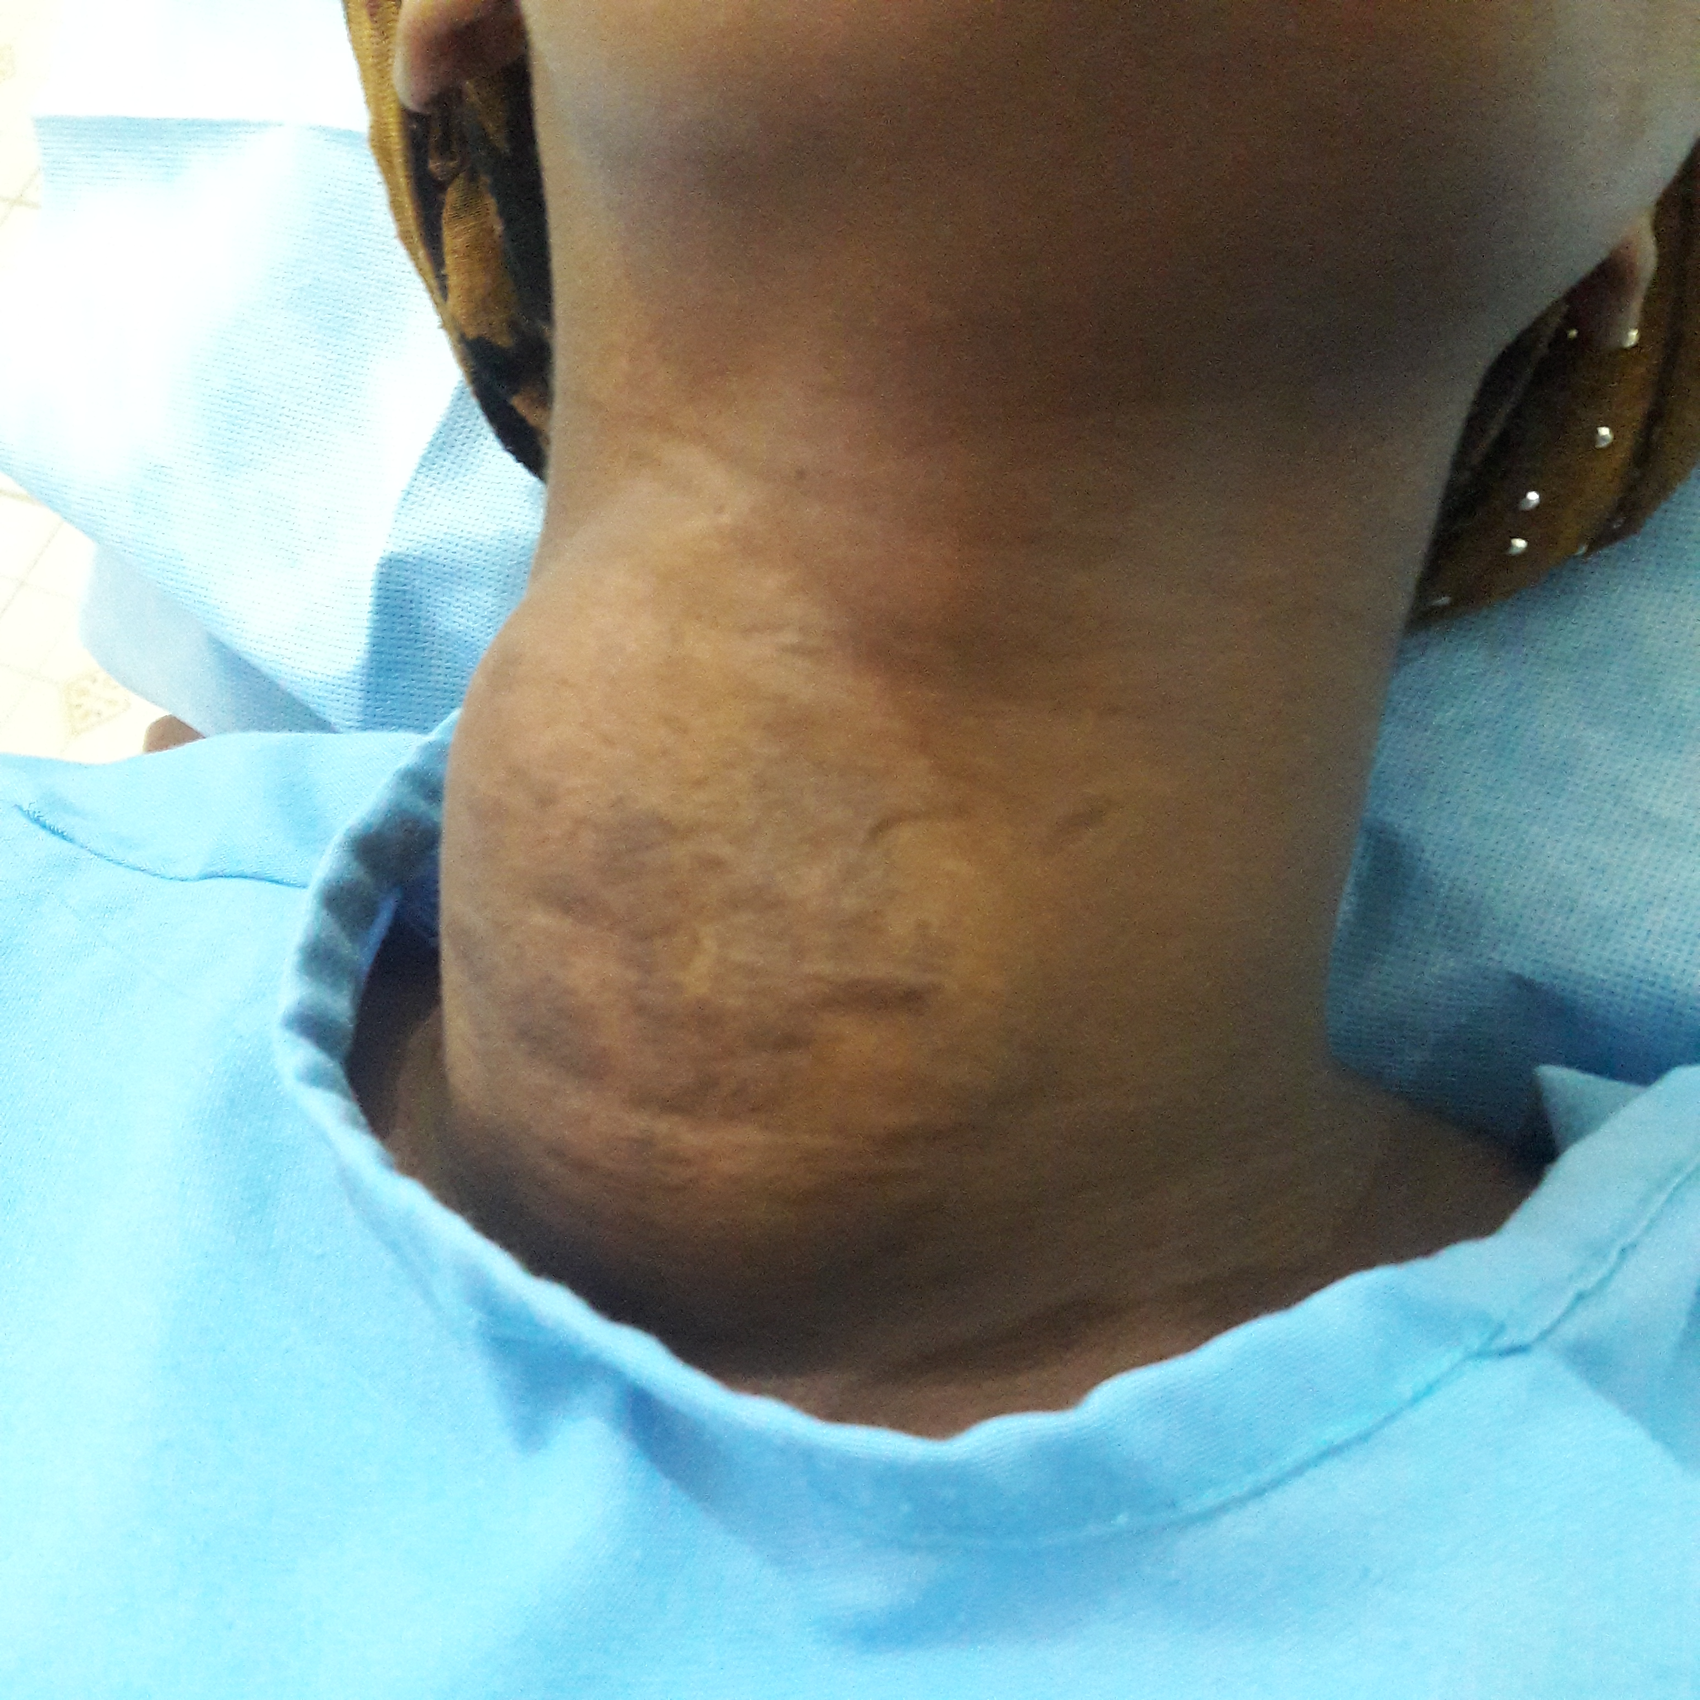
Different presentation of goiter in Somaliland
Nodular goiter
Toxic Nodular goiter

Slide 11
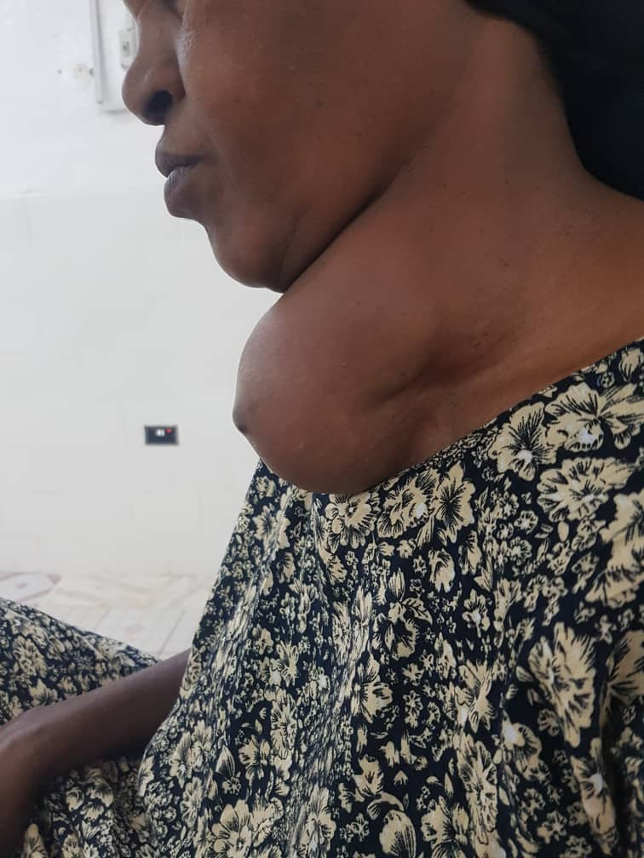
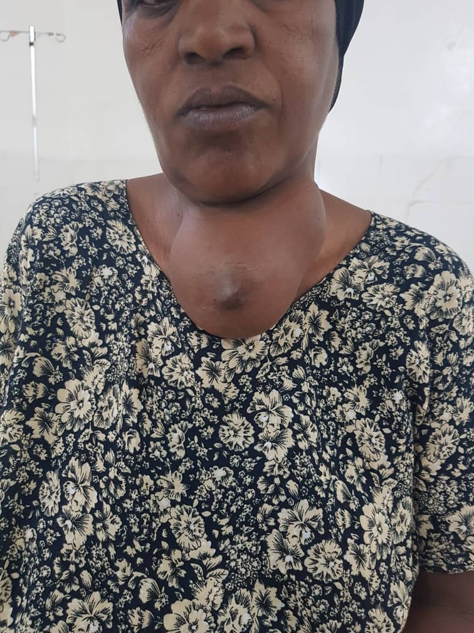
Asymeterical multinodular Gioter
Picture taken after patient’s consent

Slide 12
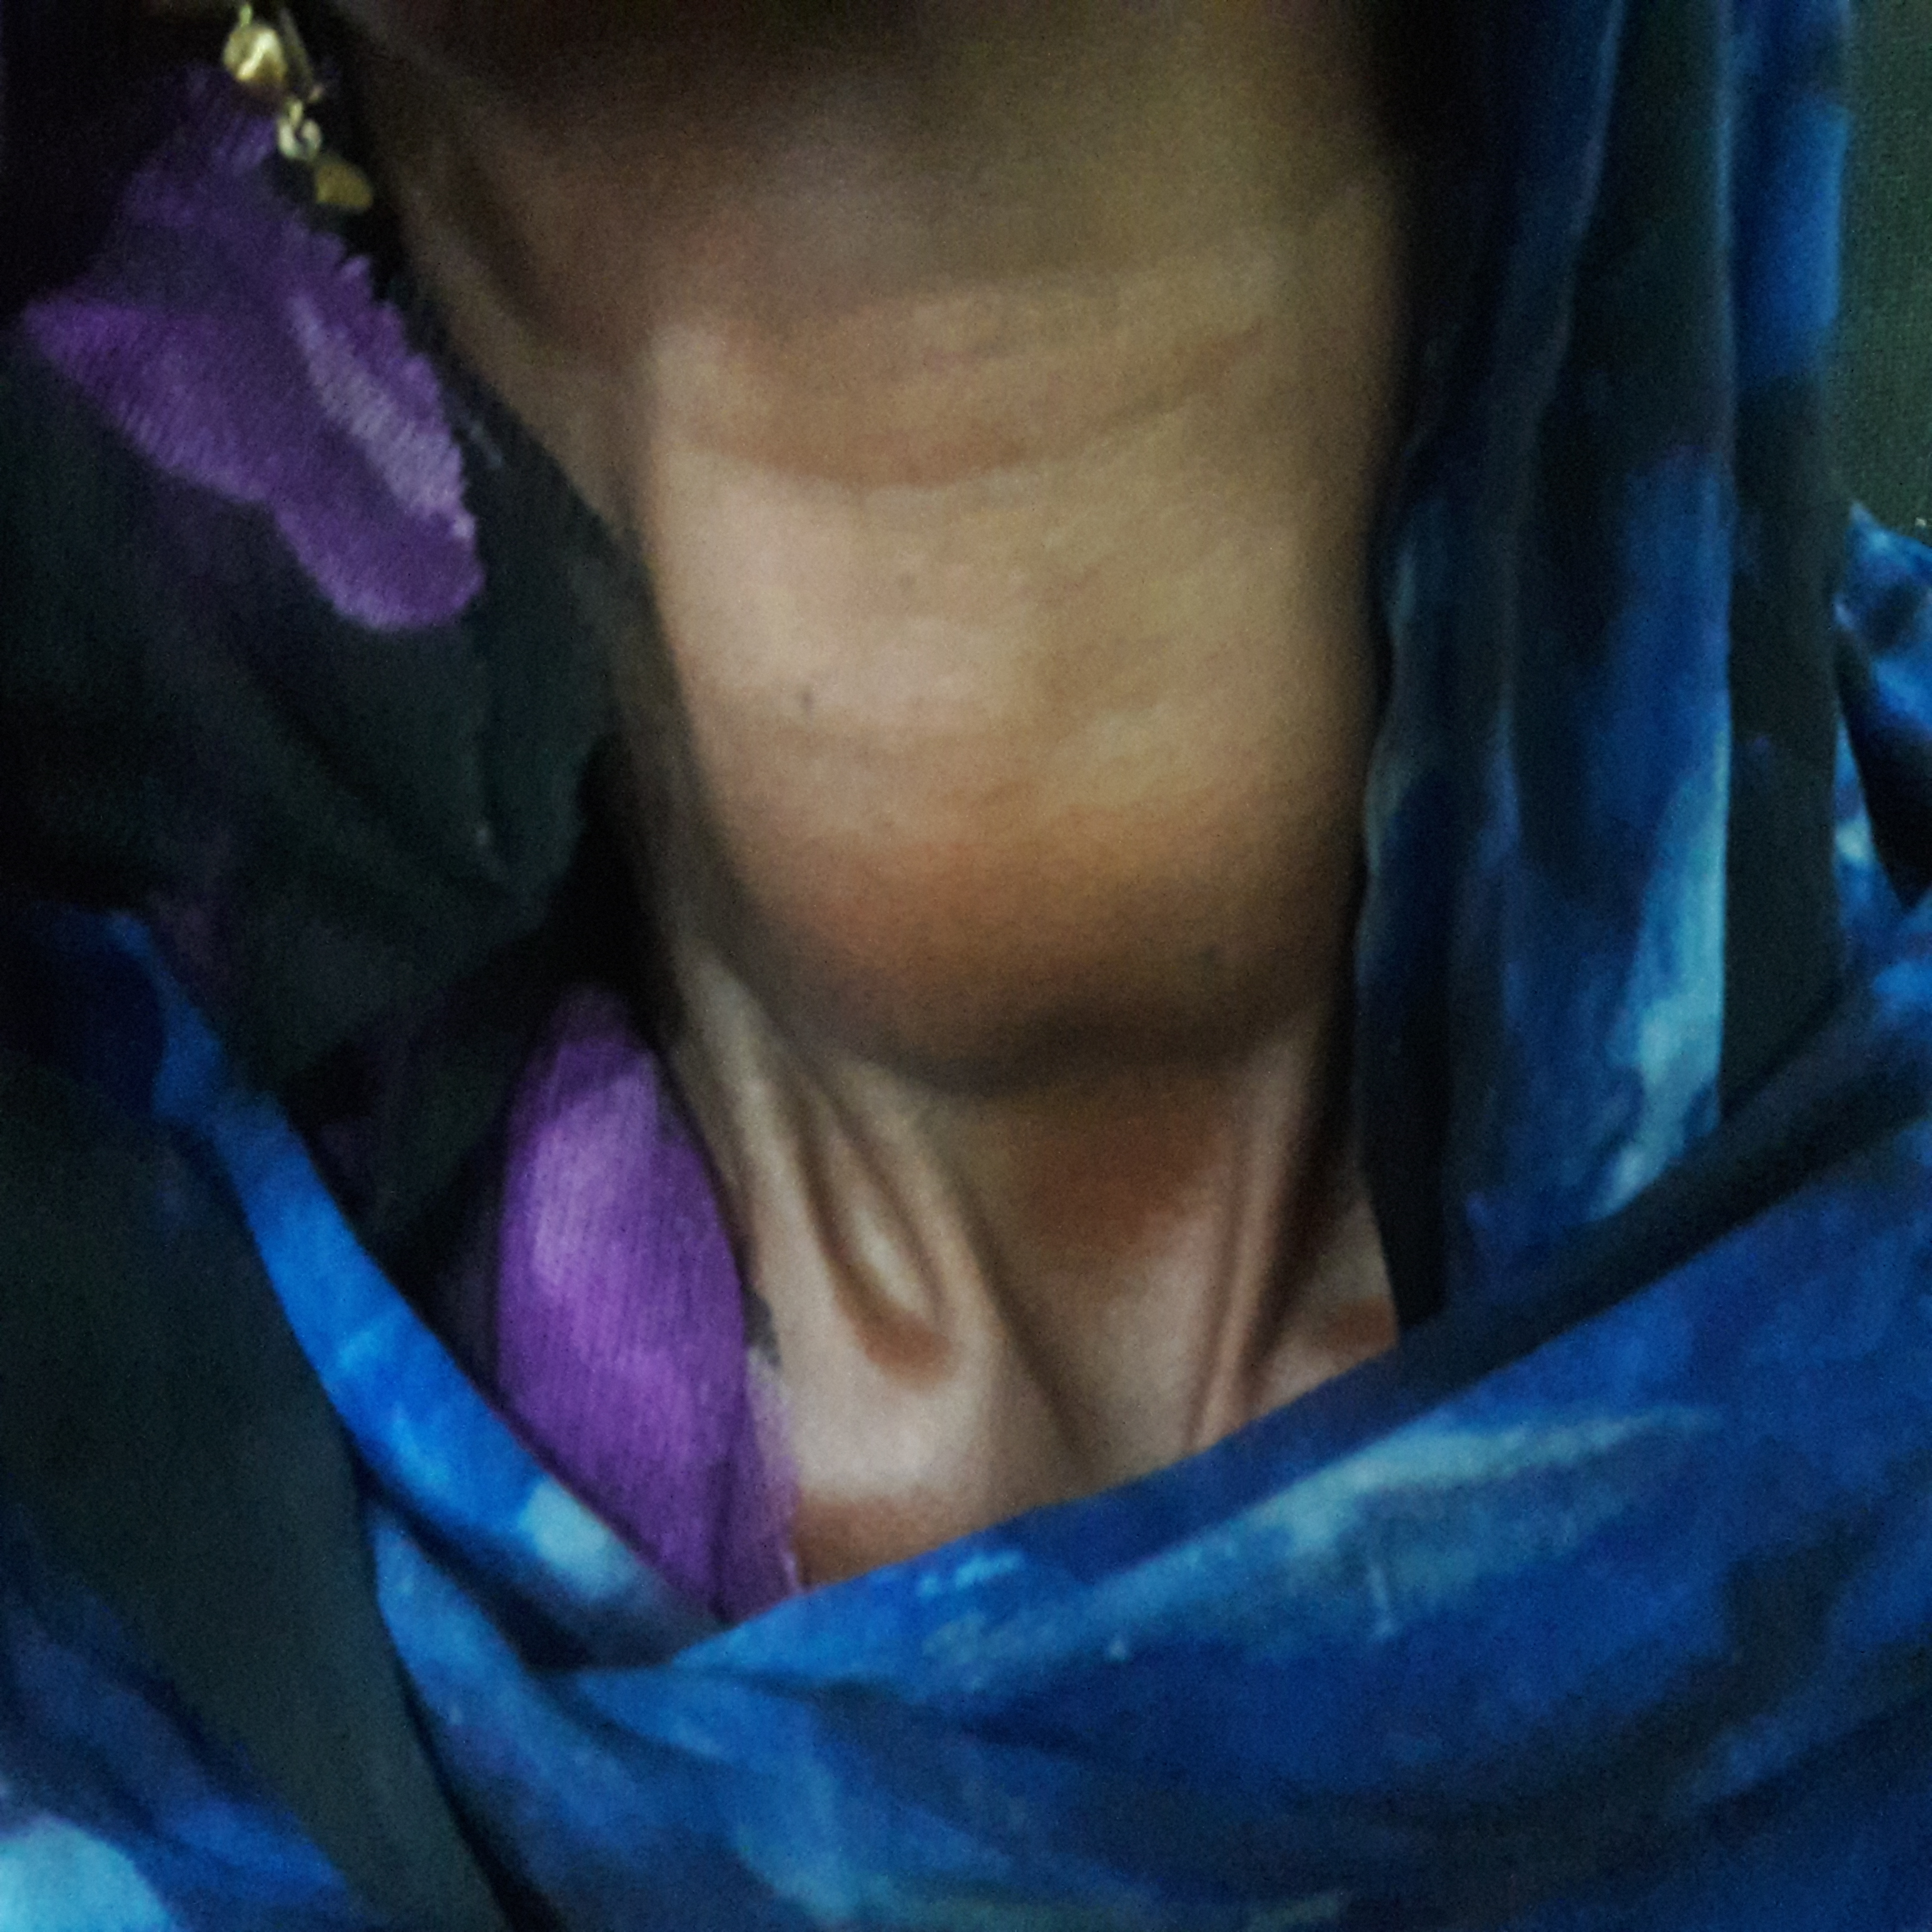
Diffuse enlargement of thyriod gland

Slide 13
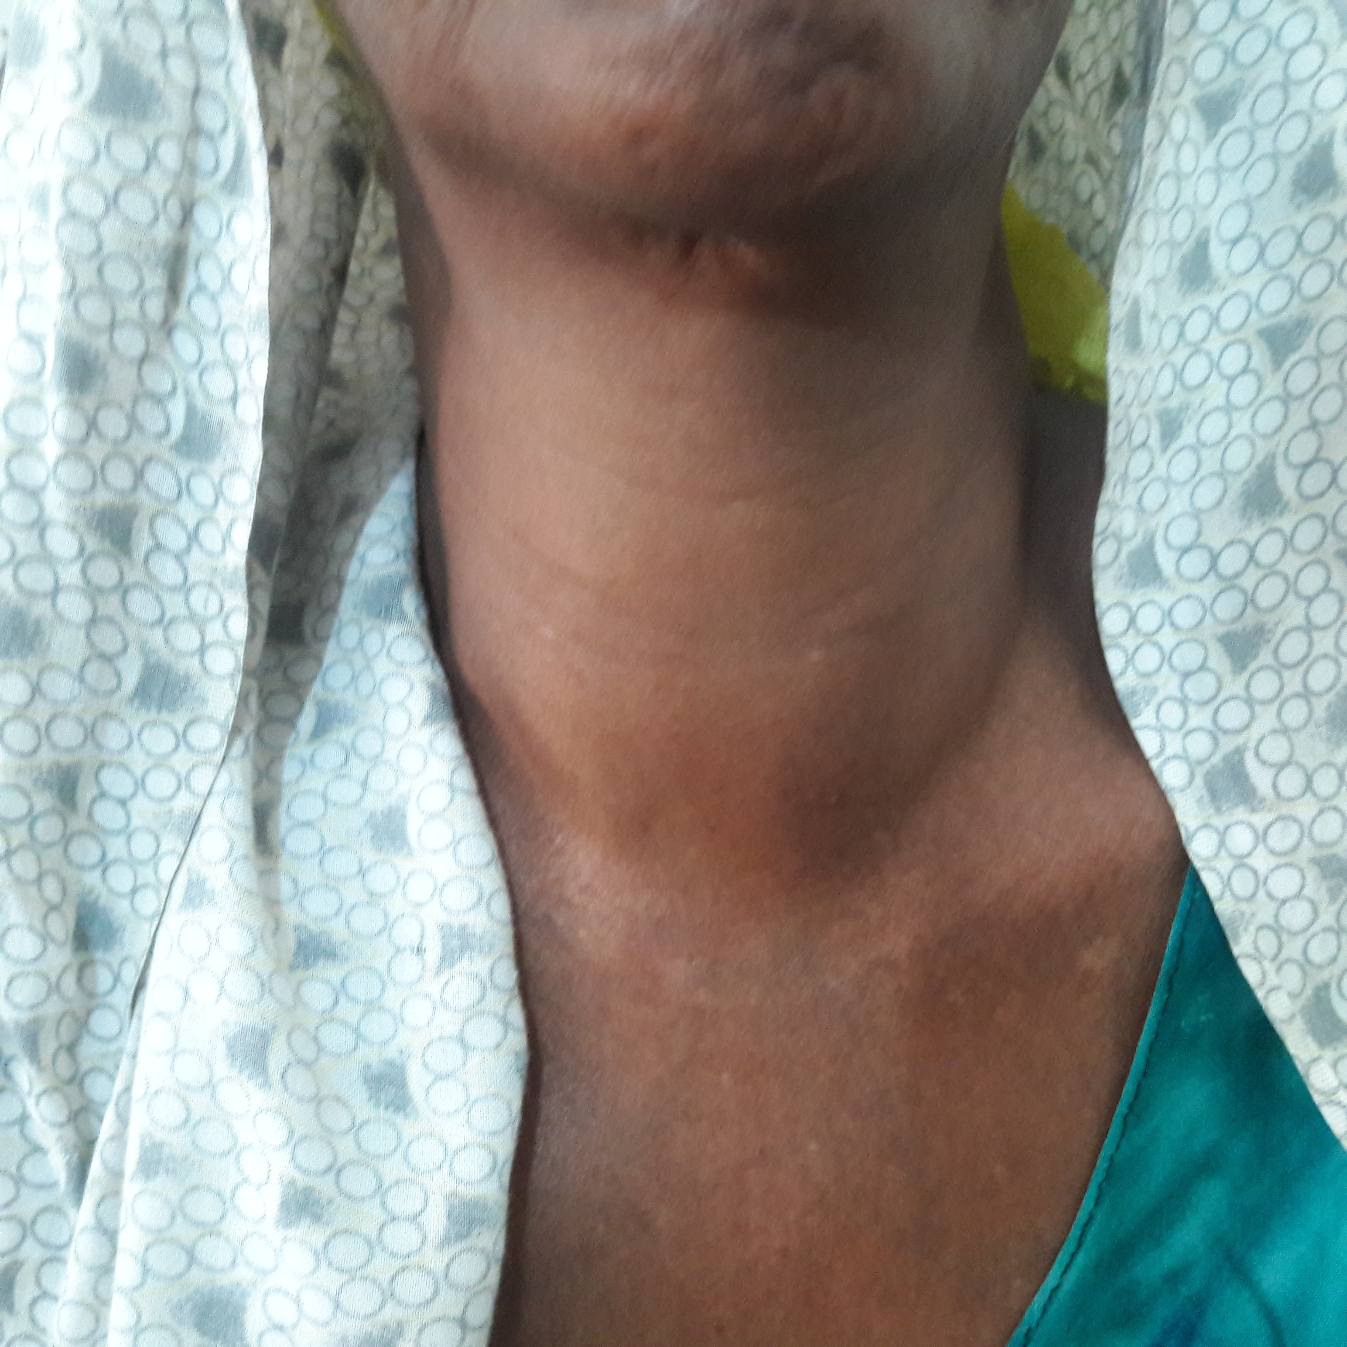
Diffuse toxic goiter

Slide 14
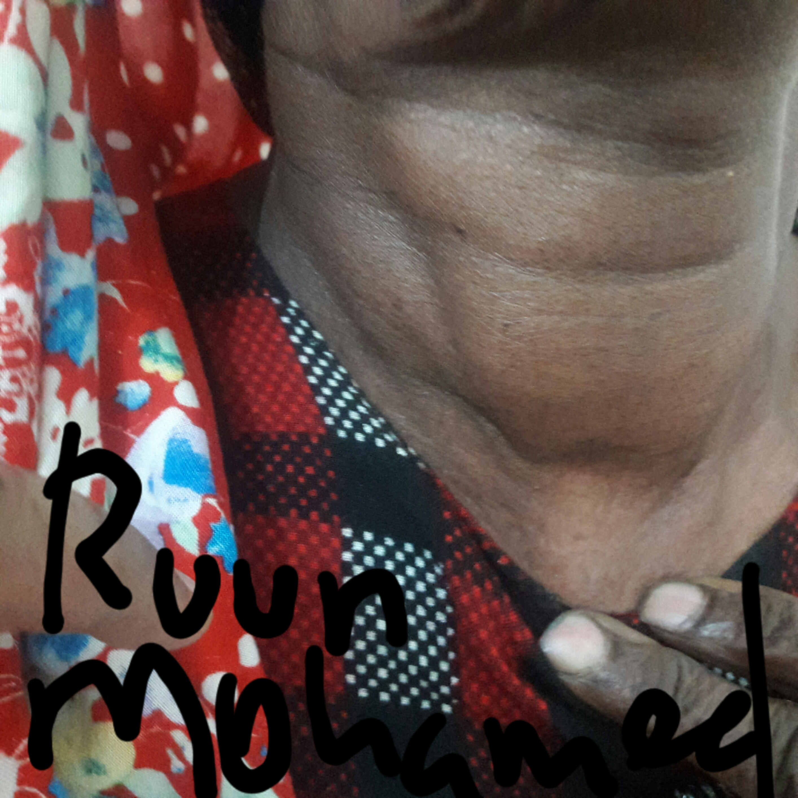
Thyroid carcinoma

Slide 15
Other pediatric presentations include mainly thyroid abscess which is less likely to see. mainly due to persistent pyriform sinus, or simple acute supporative thyroiditis following upper respiratory tract infections like this child
Thyroid abscess

Slide 16
On the other hand, malignancy of thyroid disease is quite common in Hargeisa.
Follicular carcinoma is common, anaplastic type to second most common.
Although thyroid carcinoma are most commonly treated cancer in the word. But many risk factors lead our community to die from thyroid malignancy.
so the only palliative management we can provide for such late stage presentations is only Tracheostomy.
Patient came in early as a 2nd or 3rd stage who under go surgery benefit from it.
Notes:
late presentation. Patient present thyroid disease as late as when the patient develop compressive symptoms
Lack of radioisotope scan
Lack of radiation and hormonal therapy

Slide 17
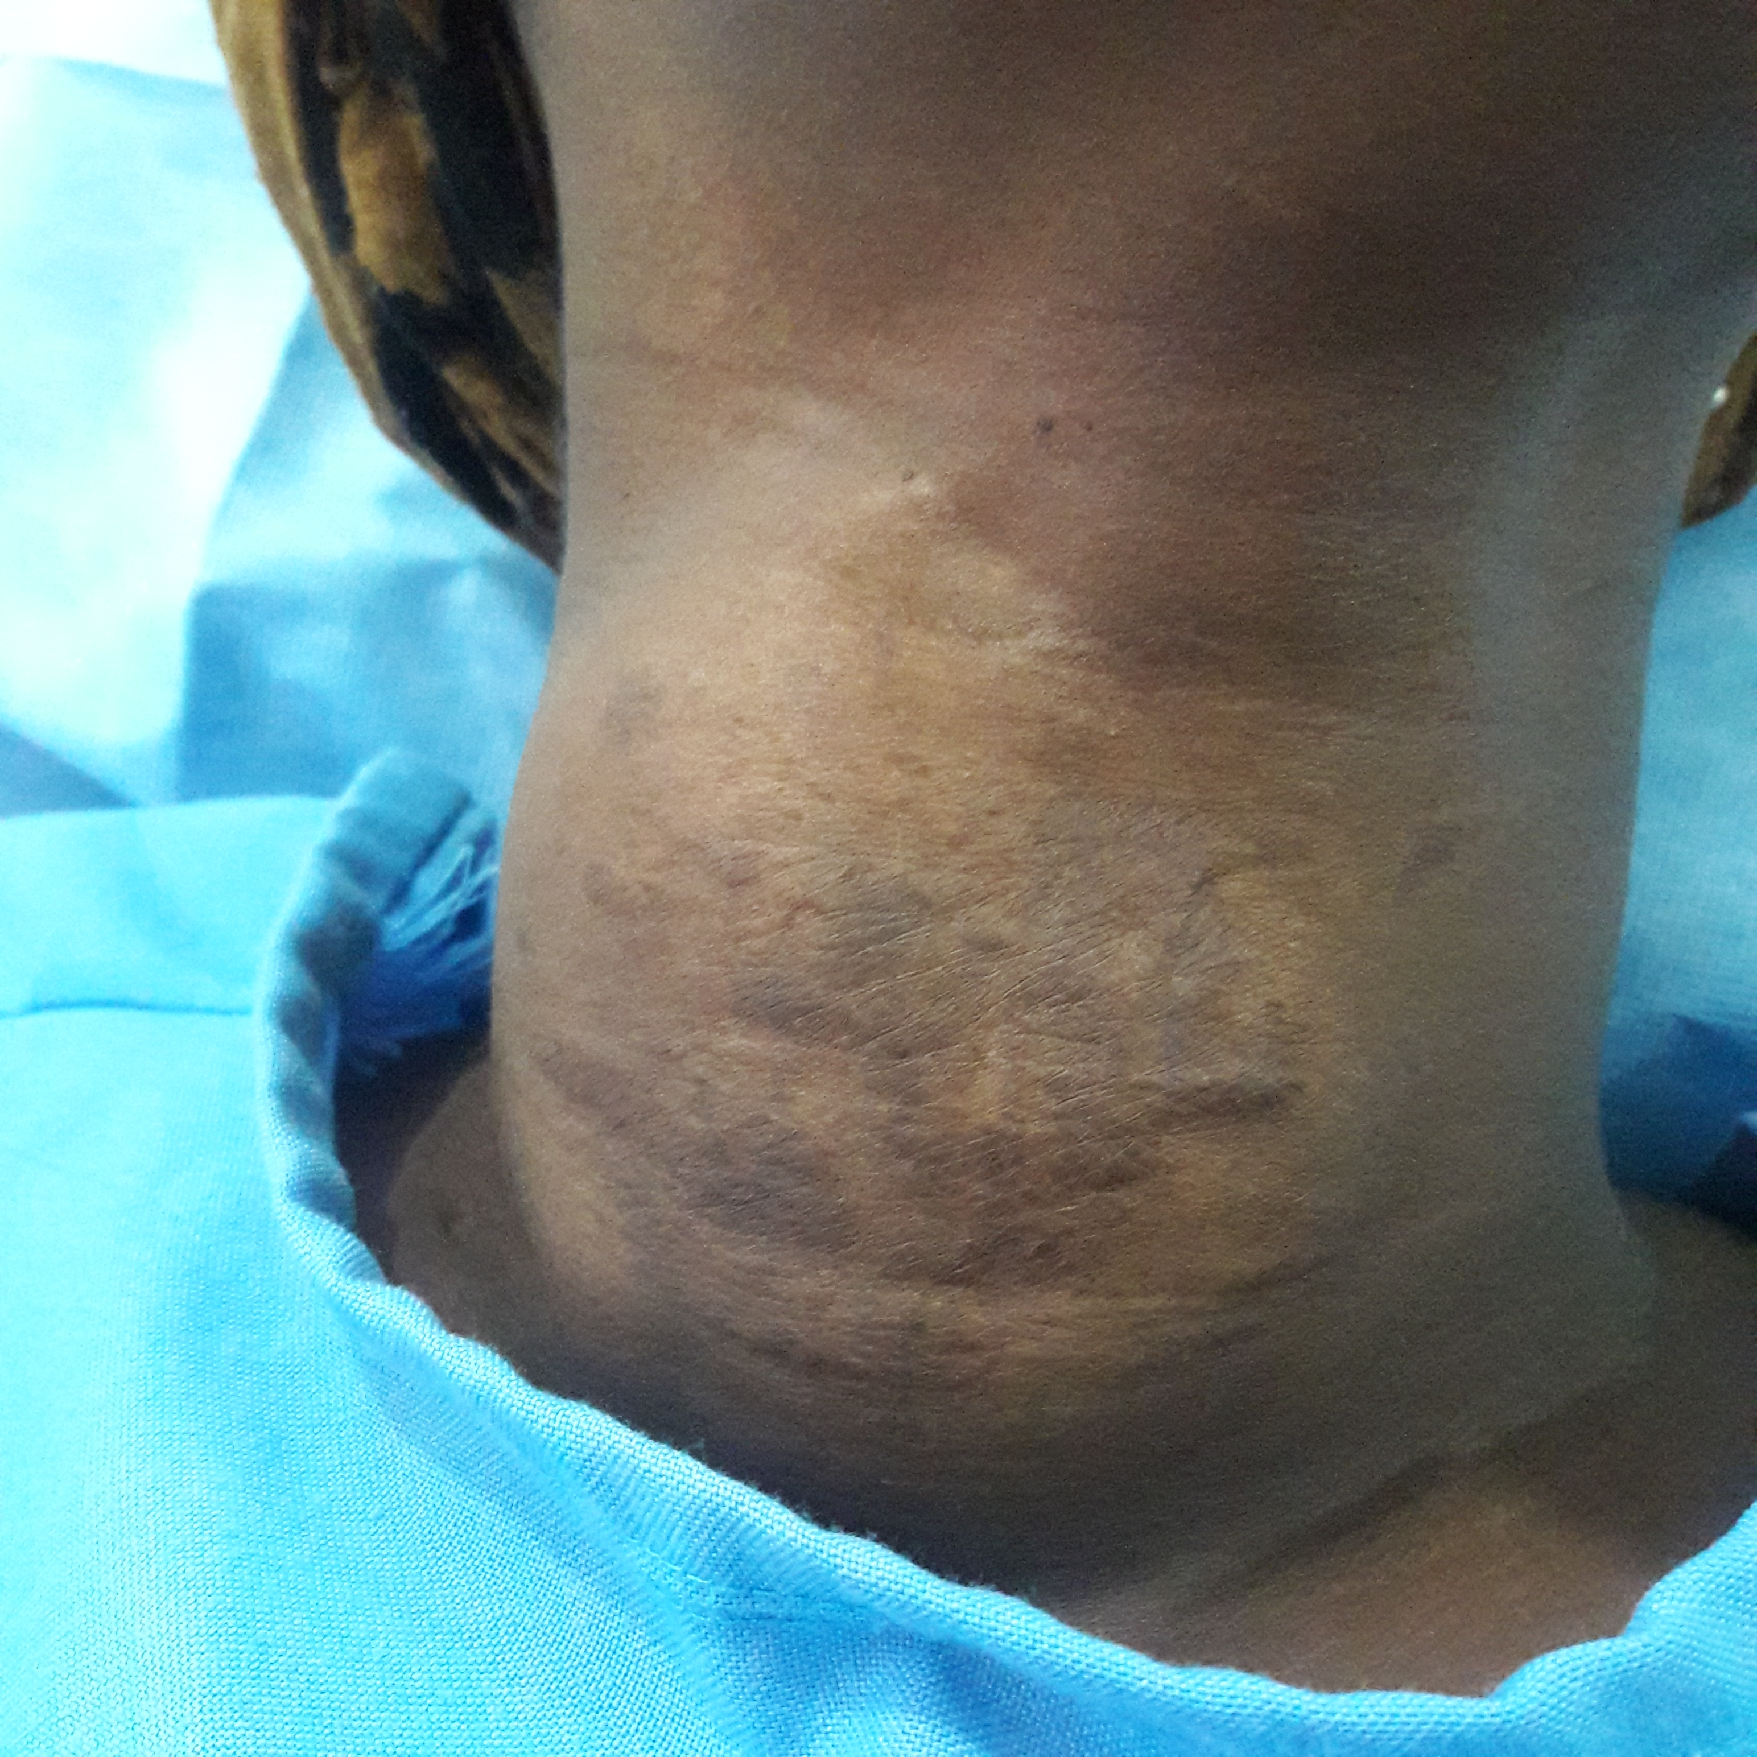
Reasons that delay medical and surgical intervention in Thyriod carcinoma patient
Traditional beliefs over medical assistant
Fear of surgery
Financial

Slide 18
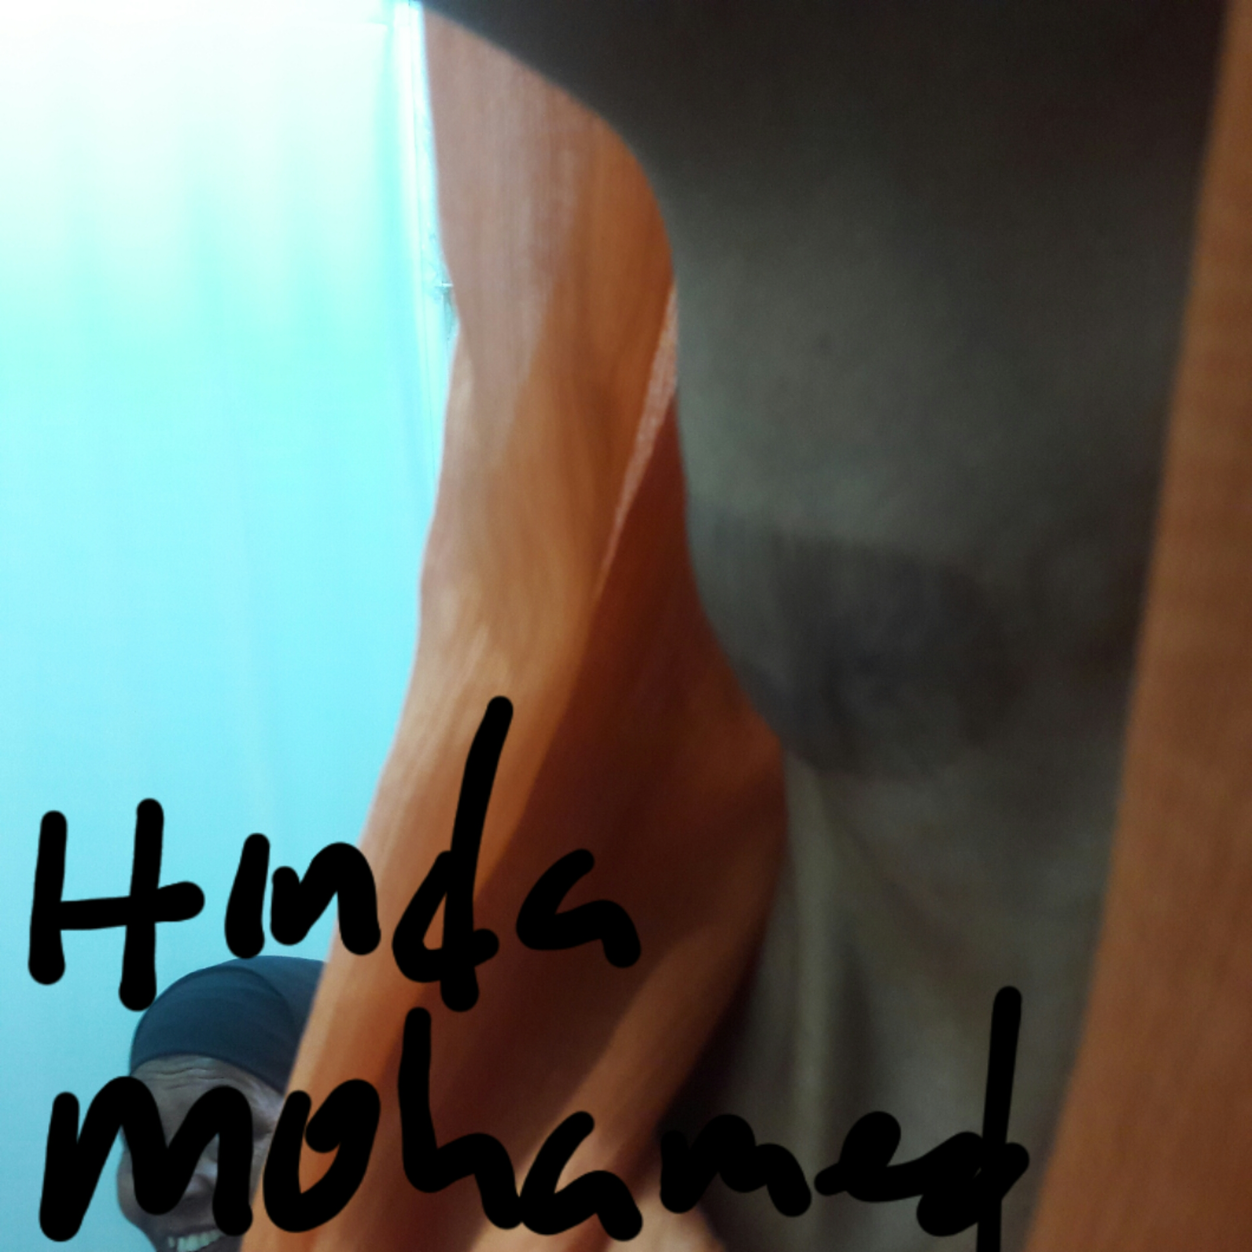

Slide 19
Thank you ….

